Slide 1
Customer Segmentation Analysis
Design Project - 4
B.Tech CSE (Artificial Intelligence and Data Science)
Team Members
Akshaya PL (22138005)
Lokeshwari Mallapu (22138023)
Krithik BM (22138010)

Slide 2
Introduction
Customer segmentation analysis is the process of dividing a company's customer base into distinct groups (segments) based on shared characteristics. This helps businesses understand their customers better, tailor marketing strategies, personalize services, and improve customer experiences.
Purpose: Helps businesses tailor their marketing, improve engagement, and boost sales.
Methodology: Involves data collection, analysis, and segmentation using statistical models.
Benefits: Enables personalization, better resource allocation, and increased customer retention.

Slide 3
Scope :
OBJECTIVE
Implement customer segmentation to categorize users based on shared behaviors and demographics, enabling businesses to tailor their marketing strategies effectively.
METHODOLOGY
Utilize K-Means clustering in Python to analyze customer data, identify patterns, and group similar customers into meaningful segments.
OUTCOMES
Enables data-driven decision-making, optimizes resource allocation, and supports business growth through actionable insights.

Slide 4
Literature Review
Some IEEE journals Referred :
A path to implementing a fresh produce e-commerce customer segmentation
method based on clustering algorithms - (DOI: 10.1109/ITOEC57671.2023.10291762)
A Two Phase Clustering Method for Intelligent Customer Segmentation - (DOI: 10.1109/ISMS.2010.48)
Customer Segmentation using K-means Clustering - (DOI: 10.1109/CTEMS.2018.8769171)
Service-mining Based on Customer Value Analysis - (DOI: 10.1109/ICMSE.2007.4421833)
Segmenting customers with data mining techniques - (DOI: 10.1109/DINWC.2015.7054234)
Review of customer segmentation method in CRM - (DOI: 10.1109/CSSS.2011.5974617)
Research on E-commerce Customer Segmentation Based on RFAC Model - (DOI: 10.1109/ICPICS52425.2021.9524108)
Improving Personalization Solutions through Optimal Segmentation of Customer Bases - (DOI: 10.1109/ICDM.2006.87)
More…

Slide 5
Title & Author Name | Year & Journal | Methods / Methodology | Key Findings | Future Work
Shuxia Ren | 2010 | Used SOM Neural Network for initial clustering. Applied K-Means Algorithm for refined customer segmentation. | Identified three customer segments (low, medium, high value). Found that 61% of customers contribute minimally, while 13% are high-value but pose a risk. | Incorporate more customer attributes for better segmentation.
Xixi He , Chen Li | 2016 | Developed a three-dimensional customer segmentation model using CLV, CS, and CA. -Used RFM model, Kano model, and BG/NBD model to determine corresponding variables. | The model effectively classifies customers into ten groups for targeted marketing. Customer segmentation based on multiple dimensions improves accuracy in marketing strategies. | Apply the approach to different e-commerce sectors for validation.
Sabri Serkan Güllüoğlu | 2015 | Used SOM Neural Network for initial clustering. Applied K-Means Algorithm for refined customer segmentation. | Identified three customer segments (low, medium, high value). Found that 61% of customers contribute minimally, while 13% are high-value but pose a risk. | Incorporate more customer attributes for better segmentation.
Tianyi Jiang, Alexander Tuzhilin | 2006 | Utilized Hierarchical Clustering for initial segmentation. Applied DBSCAN Algorithm to detect outlier customers. | Discovered four distinct customer groups based on spending behavior. Identified 20% of customers as frequent buyers with high retention. | Explore deep learning approaches for dynamic segmentation.

Slide 6
Wang Yinghui, Liu Xilin | 2010 | Conducted RFM Analysis (Recency, Frequency, Monetary) for initial segmentation. Used XGBoost Model to predict high-value customers. | Found two major customer types: impulse buyers vs. loyal shoppers. Identified 40% of high-frequency buyers as potential brand advocates. | Implement personalized marketing strategies based on segmentation.
Tushar Kansal | 2018 | Applied K-Means clustering for customer segmentation. Determined optimal clusters using the Elbow Method. | Identified three main customer clusters: High-Value Customers, Occasional Shoppers etc. | Develop targeted marketing strategies for each cluster.
Anu Gupta Aggarwal | 2020 | Combined Fuzzy-AHP and RFM Model for customer segmentation. Used Fuzzy-AHP to assign weights to RFM factors (Recency, Frequency, Monetary) based on expert judgment. Segmented customers using weighted RFM scores. | Identified four customer segments: Loyal Customers, At-Risk Customers, Potential Loyalists, and Lost Customers. Found that 20% of customers contribute to 70% of revenue. | Implement retention strategies for At-Risk Customers.
E.Y.L Nandapala | 2020 | Used K-Means clustering for segmentation. Customers were segmented into six clusters based on annual income and spending score. | Identified six distinct customer clusters. Businesses can use these clusters to develop targeted marketing strategies and improve customer engagement. | Helps organizations make data-driven decisions, introduce new products/services, and refine existing offerings

Slide 7
Lu Siyue | 2019 | Implemented a customer value-based segmentation model. Used machine learning techniques to predict high-value customers. Applied RFM (Recency, Frequency, Monetary) analysis and clustering methods like K-Means. | Identified distinct business user segments based on purchasing behavior. High-value customers were found to have consistent spending patterns and high engagement levels. | Improve segmentation using real-time data and deep learning techniques.
Morteza Namvar | 2010 | Developed a new segmentation approach combining RFM (Recency, Frequency, Monetary), Demographics, and LTV (Lifetime Value). Used data mining techniques for clustering. | The new method provided a more precise segmentation. Identified key customer behaviors and patterns for better decision-making. | Improve segmentation by integrating real-time behavioral data.

Slide 8
Methodology
1. Data Collection
Gather customer transaction data, including Recency, Frequency, and Monetary (RFM) attributes.
Incorporate demographic and behavioral data to enhance segmentation accuracy.
2. Data Preprocessing
Handle missing values and outliers to improve data quality.
Normalize and scale relevant features for optimal clustering performance.
3. Customer Segmentation
Apply K-Means Clustering to segment customers based on RFM scores.
Further refine clusters using demographic attributes for deeper insights.
Evaluate cluster quality using metrics such as Silhouette Score and Elbow Method.

Slide 9
Methodology
4. Insights & Decision-Making
Identify high-value customer groups for targeted marketing strategies.
Use insights to optimize customer engagement, retention, and personalized campaigns.

Slide 10
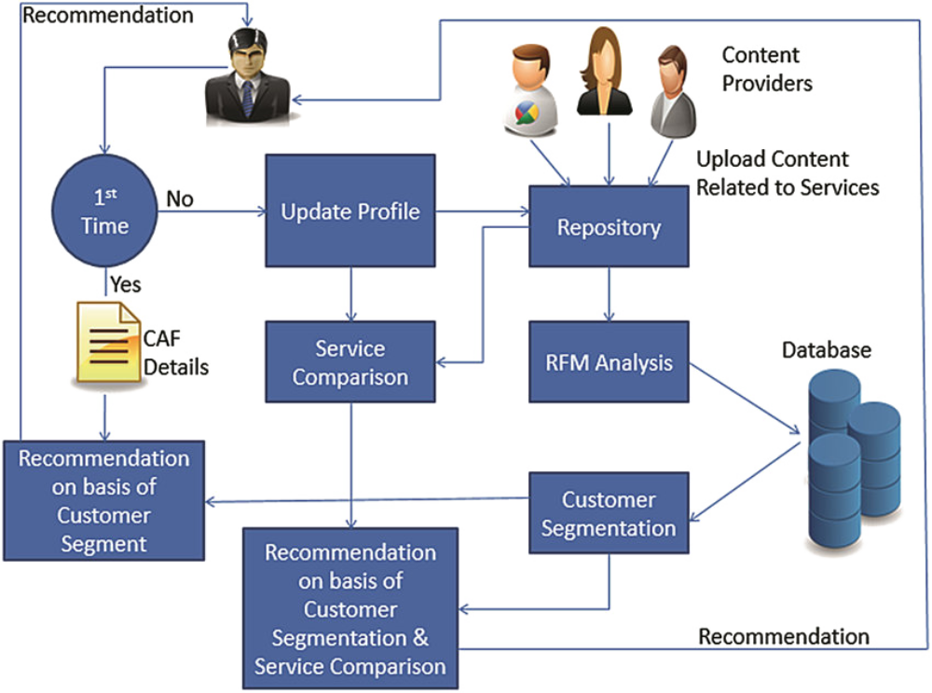
Architecture Diagram :

Slide 11
Why K-Means Was Chosen:
Both hierarchical clustering and K-Means were considered for this dataset. Hierarchical clustering, although useful for visualizing nested clusters, did not perform well in terms of speed and scalability. It required more memory and became inefficient as the dataset size increased.
The clustering results were also less distinct and harder to interpret clearly. In contrast, K-Means provided faster execution, handled larger data smoothly, and produced well-defined clusters.
Considering these factors, K-Means was more efficient and suitable for this dataset.

Slide 12
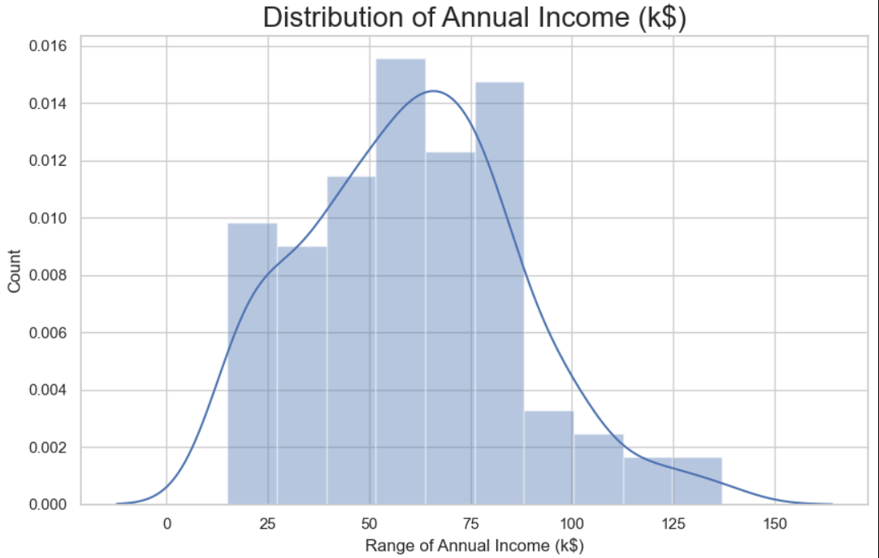
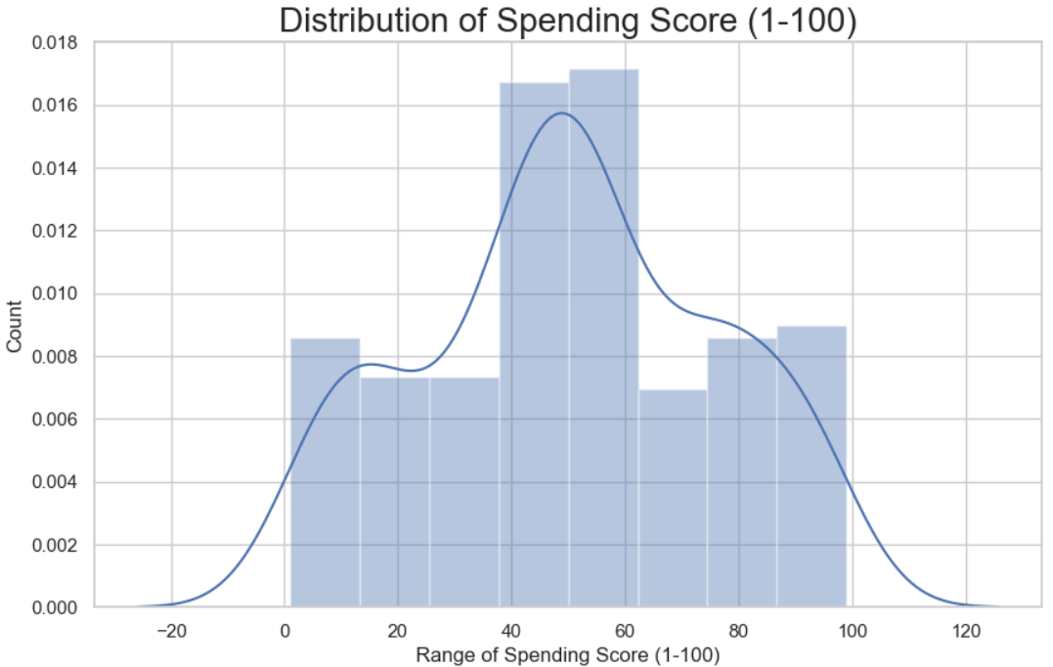
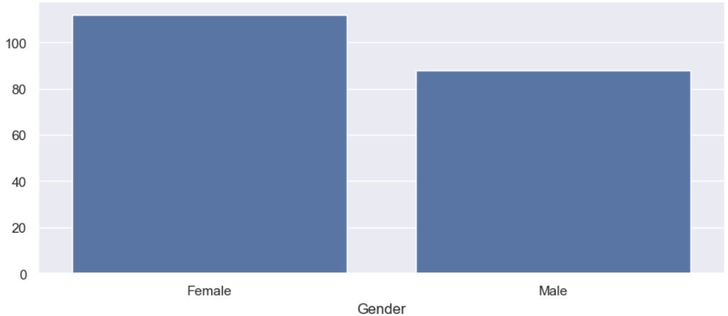
Outputs :

Slide 13
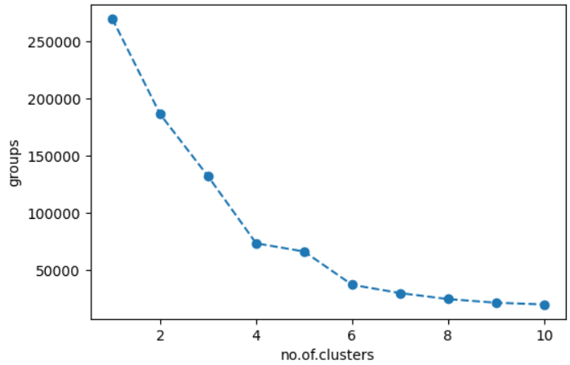
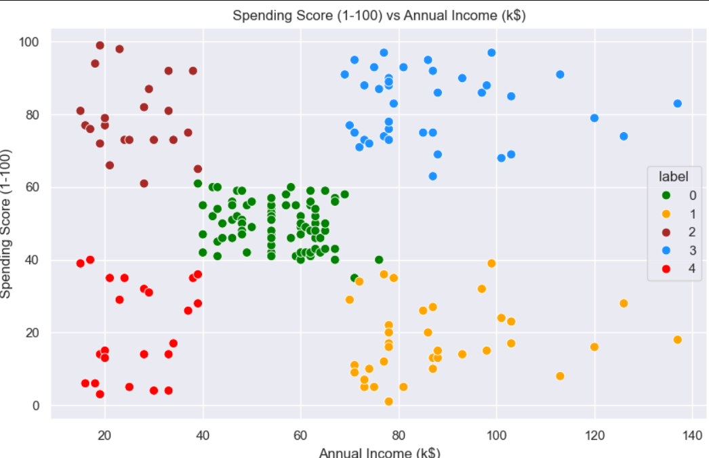
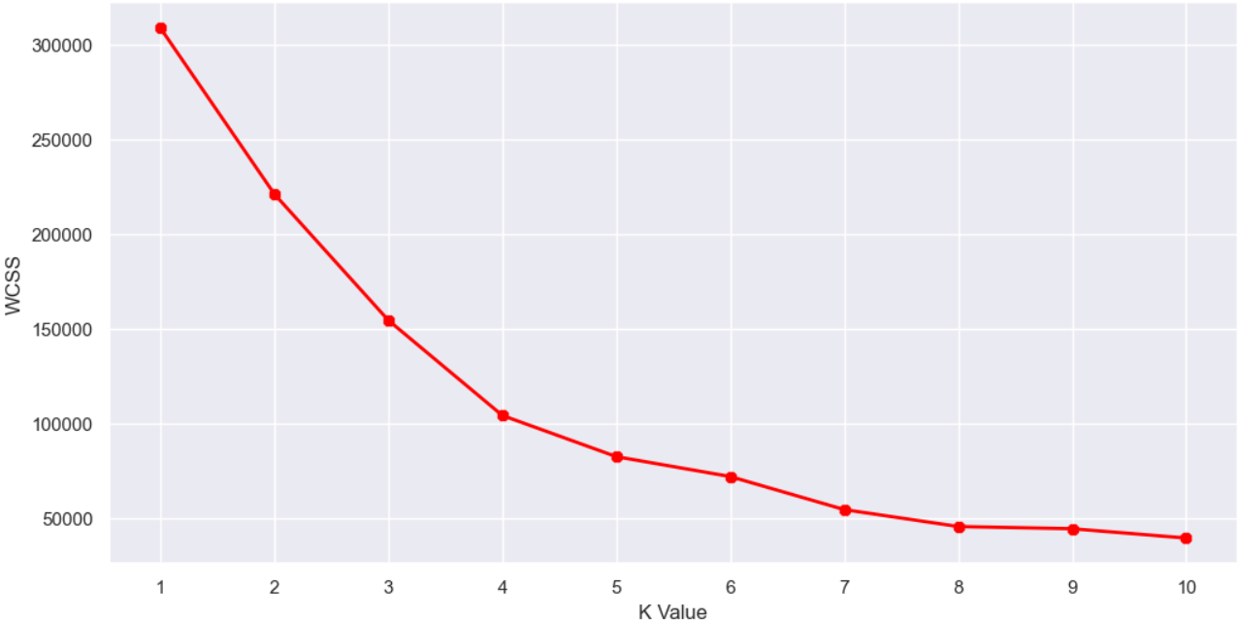
Outputs :

Slide 14
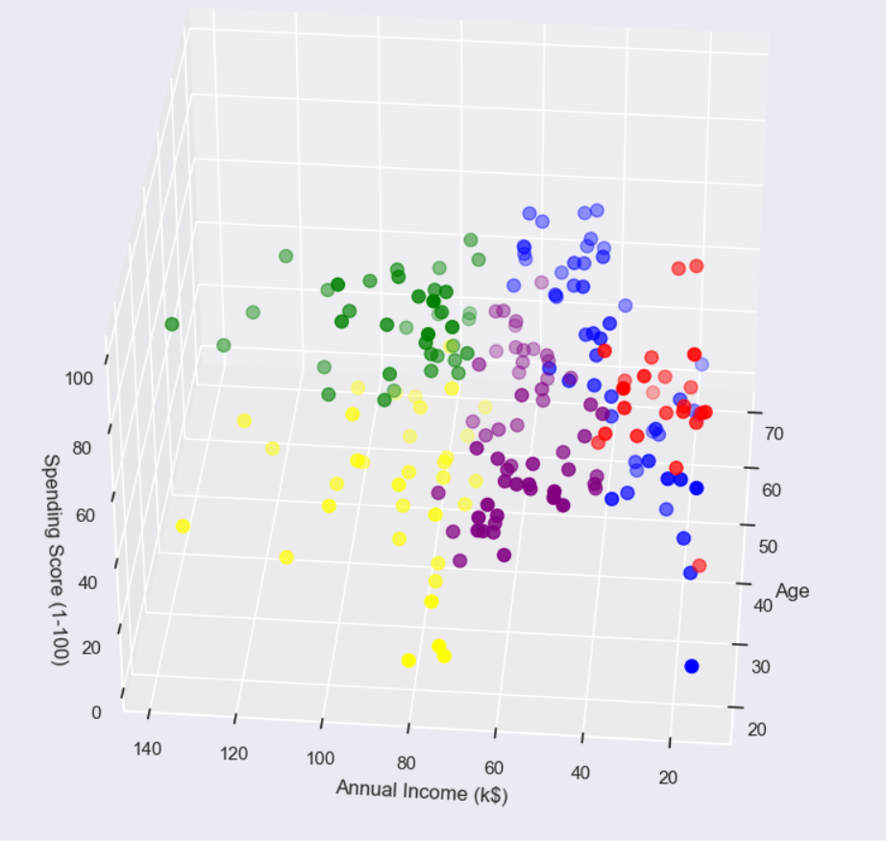
Outputs :

Slide 15
Conclusion :
Through meticulous data collection, preprocessing, feature engineering, and the application of K-Means clustering, we have effectively segmented the supermarket's customer base into distinct groups characterized by their purchasing behaviors and transaction patterns.
These insights empower the supermarket to tailor marketing strategies, optimize product offerings, and enhance customer engagement. By leveraging data-driven segmentation, the supermarket is well-positioned to foster customer loyalty and drive business growth.

Slide 16
Thanks !
Team Members
Akshaya PL (22138005)
Lokeshwari Mallapu (22138023)
Krithik BM (22138010)

